Slide 1


OTHM LEVEL 6
Diploma in Occupational Health and Safety
Element 3
Risk
and
Incident Management

Slide 2
Learning Outcomes:
Understand the processes and strategies for identifying hazards and evaluating risk levels when carrying out risk assessments in an organisation.
Understand the strategies and techniques of risk control.
Understand the models of loss causation, analysis of loss data and the importance of incident investigation.
Understand processes and strategies to manage health and safety incidents in an organisation.

Slide 3
Element 3.1
Identifying Hazards

Slide 4
Do you know?
Hazard
Something has the potential to cause harm
Risk
Combination of the likelihood of a harm and the severity of that harm

Slide 5
Hazard Categories
Physical
- e.g. Electricity, Noise, Vibration, Radiation, Machinery
Chemical
- e.g. Mercury, Solvents, Carbon Monoxide
Biological
- e.g. Bacteria, hepatitis
Ergonomic
- e.g. manual handling, repetitive tasks
Psychological
- e.g. stress, violence

Slide 6
Objectives of Risk Assessment
Prevent Death and personal injury
Prevent the direct and indirect costs that follow on from accidents
Changing unsafe practices
Check the effectiveness of control measures
Identifying groups at risk
Identifying specific hazards
Current and future training needs

Slide 7
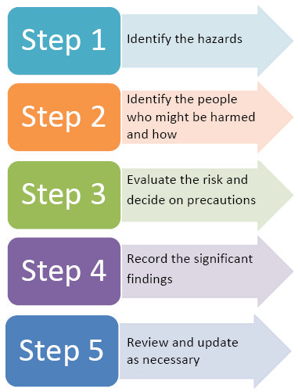
5 Steps of Risk Assessment

Slide 8
Step 1: Identify the Hazards
Safety Inspection
Accident Investigation Reports
Consulting with employees
Examine OHS Documents
Talking to the employees

Slide 9
Step 1: Identify the Hazards
IDENTIFY HAZARDS IN WORKPLACE
Physical
Chemical
Biological
Ergonomic
Psychological

Slide 10
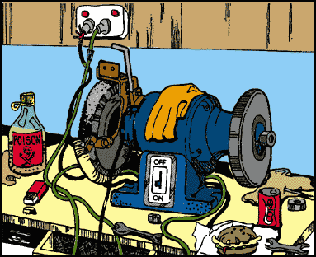
Step 1: Identify the Hazards

Slide 11
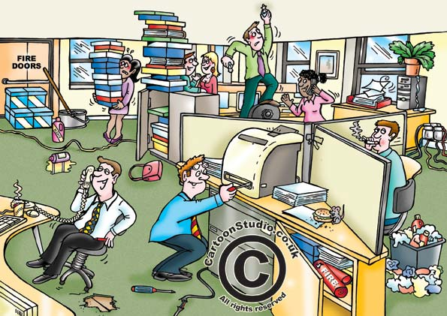
Step 1: Identify the Hazards

Slide 12
Step 2: Identify the People at Risk
Employees
Maintenance staff
Cleaners
Contractors
Visitors
Members of the public

Slide 13
Vulnerable Groups
People at Special Risk:
Young people
New or expectant mothers
Disabled workers
Lone workers

Slide 14
Step 3: Evaluate the Risk
What is risk?
It is a measure of likelihood of harm occurring and the severity of that harm.
Or simply say:
Risk = Likelihood × Severity

Slide 15
Risk Assessment Matrix

Slide 16
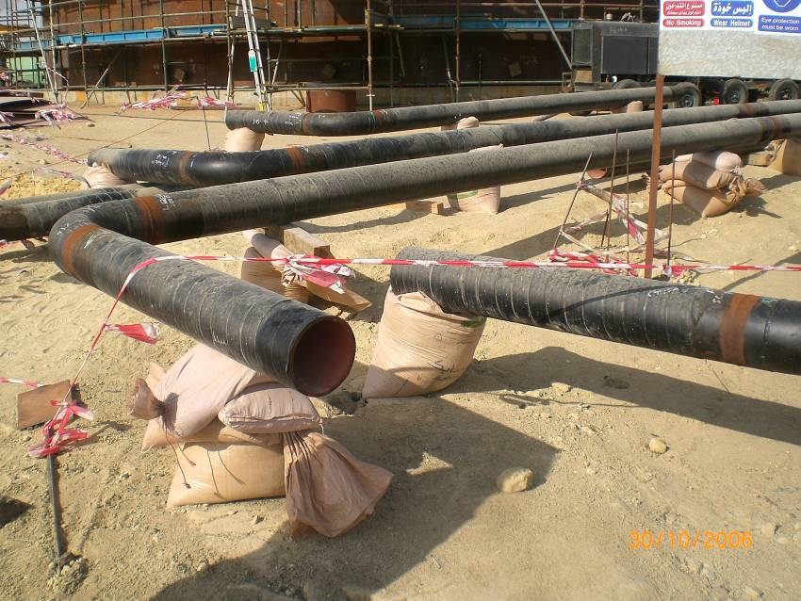
Exercise 1- Evaluate Risk

Slide 17
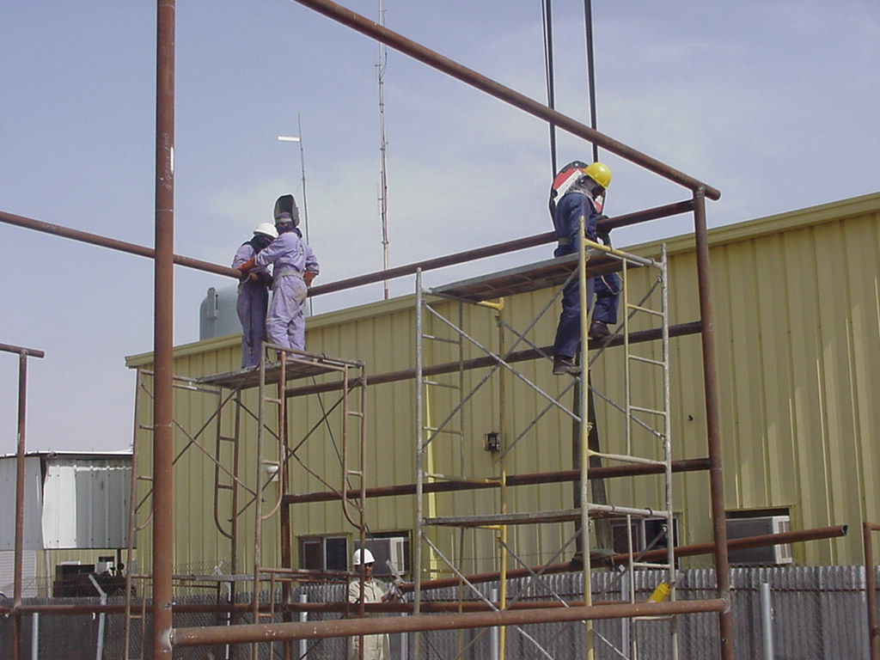
Exercise 2 - Evaluate Risk

Slide 18
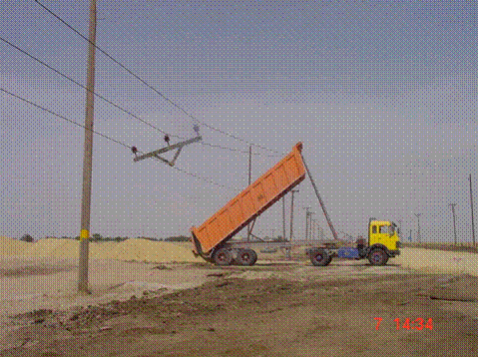
Exercise 3 - Evaluate Risk

Slide 19
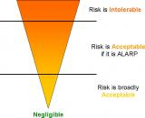
ALARP
The results of the risk assessment must be prioritised:
High priority
- Immediate action required
Medium priority
- Action required within a weeks
Low priority
- Action required within months
Risk Intolerable
RISK
Risk Acceptable
(ALARP)
Risk Broadly Acceptable
Negligible

Slide 20
Step 4 – Record Significant Findings
Typical content:
The significant findings of the assessment should be recorded and kept.
Control measures need to be implemented.
There should be a record of all hazards, the risks they present and what precautions are in place to protect people from harm.

Slide 21
Step 5 - Review
Significant change in:
Process
Substances
Equipment
Workplace environment
Personnel
Law
If it is no longer valid
Accident
Near miss
Ill-health
Periodically e.g. annually

Slide 22
Young Persons
Under 18 (National Law)
Lack of experience
Physical and mental maturity
Poor risk perception
Influenced by peer group
Eager
Control measures:
Prohibit certain high risk activities, e.g. high risk machinery
Restrict work patterns and hours, e.g. no overtime
Train and Supervise

Slide 23
Pregnant Workers
Hazards:
Certain Chemicals, e.g. Lead
Certain Biological Agents, e.g. Virus
Manual Handling
Temperature Extremes
Whole Body Vibration
Ionising Radiation
Night Shifts
Stress
Violence

Slide 24
Disabled Workers
RISK TO THE DISABLE WORKERS
Reduce mobility for safe access and egress and emergency evacuation
Ability to access welfare facilitates
Reduce sensory input to recognize hazards and emergencies e.g. hearing, eye sight
Reduced communication ability e.g. speech, hearing or eyesight
Reduce ability to lift, carry and move objects
Ergonomic hazards such as reach distances

Slide 25
Lone Workers
Workers especially vulnerable and more at risk:
Of violence
- e.g. : Prison Officer, Mental Health
Nurse
If they are injured or ill
- e.g. : Confined Space Entry
Stress

Slide 26
Suitable and Sufficient Risk Assessment
Ensure that all aspects of work activity are reviewed
Ensure that non-routine operations are taken into account
Identify the significant hazards and risks arising out of the work activity
Evaluate the risk and Identify the control measures
Identify and priorities the measures that need to be taken to comply with the relevant statutory provisions,
Ensure that the RA is appropriate to the nature of the work
Residual risk should be low
Ensure staff undertaking assessment have sufficient knowledge and experience
Ensure that the risk assessment is remain valid for a reasonable time

Slide 27
Element 3.2
Risk Control

Slide 28
General Principles of Prevention
Avoid risks
Evaluate Risk Assessment
Controlling hazards at source
Adapting work to the individual
Adapting to technical progress
Substitute risk
Policy , Safe system of work
Giving priority to collective protective measures
Training, information and supervision

Slide 29
Hierarchy of Risk Control
Elimination
Best method of dealing with a hazard is to eliminate it
Example: Outsourcing the painting activity
Substitution
Substituting or replacing a hazard or hazardous work practice with a less hazardous one
Example : Mercury cell to Membrane cell
Engineering controls
Isolation, total enclosure
Separation, segregation
Partial enclosure
Safety devices

Slide 30
Hierarchy of Risk Control
Administrative controls
Safe systems of work
Reduced exposure
Reduced time of exposure, dose
Information, Instruction, Training and Supervision
Personal Protective Equipment (PPE)
Provision of PPE Example – Helmet, Gloves, Mask etc.

Slide 31
Personal Protective Equipment (PPE)
Personal Protective Equipment Regulations 1992
Supply suitable PPE:
Appropriate for risk
Ergonomic
Fits
Doesn’t increase overall risk
Complies with standards
Suitable storage
Information, instruction and training
Enforce use of PPE
Replace or repair damaged or lost items

Slide 32
Personal Protective Equipment (PPE)
Benefits of PPE | Limitations of PPE
Interim control Some situations only control option Emergency back up Cheap (short term) Immediate protection | Doesn’t remove hazard Only protects the wearer Requires good fit Relies on wearer Requires training Uncomfortable May increase overall risk Incompatibility Unpopular so often unworn Fails to danger No good if wrongly selected Contamination Expensive long term

Slide 33
Element 3.3
Investigating Incidents

Slide 34
Reasons to carry out investigations
Identify the causes
Prevent recurrence
Collect evidence
Legal reasons
Insurance purposes
Staff morale
Disciplinary purposes
To update risk assessments
Discover trends

Slide 35
Reasons to carry out investigations
Unsafe Act : It is an act of an individual who violates the safety norms.
Rash driving
Not wearing the PPE
Working in an unsafe manner
Horseplay

Slide 36
Reasons to carry out investigations
Unsafe Condition : an environment or a location which is unsafe to work or cause an accident
Opening on a floor
Stair case without handrail
Dusty atmosphere
Poor housekeeping
Defective equipment

Slide 37
accident Investigation procedure
Step 1
Gather factual information
Step 2
Analyse the information and draw conclusions
Step 3
Identify suitable control measures
Step 4
Plan the remedial action

Slide 38
Step 1 - Gathering Information
Secure the scene
Identify witnesses
Collect factual information
Photo/sketch
Measurements
Notes
Mark up plans
Samples
Interview witnesses
Examine documents

Slide 39
Document Examination
Site plans
Company health and safety policy
Risk assessments
Training records
Safe systems of work
Permits-to-work
Maintenance records
Previous accident reports
Sickness records

Slide 40
Step 2 – Analysing Information
Immediate Causes:
Unsafe acts
Unsafe conditions
Underlying or Root Causes:
Reasons behind the immediate causes
Often failures in the management system
No supervision
No PPE provided
No training
No maintenance
No checking or inspections
Inadequate or no risk assessments

Slide 41
Step 3 – Identifying Suitable Control Measures
For Immediate Causes
Clean up the spill
Replace the missing guard
Relocate the trailing cable
For Underlying or Root Causes
Training
Maintenance
Need to make changes in management system

Slide 42
Step 4 – Plan the Remedial Actions
Dangerous conditions must be dealt with immediately
Interim actions may be possible
Underlying causes will require more complex actions
will take Time, Effort, Disruption, Money
need for prioritisation
Recommended action | Priority | Timescale | Responsible
Introduce induction training for all new FLT drivers | Medium | 1 month | Warehouse Manager

Slide 43
Immediate Action when accident happens
Provide First Aid to the causality
Call for medical assistance if necessary
Make the accident area safe
Barricade the accident spot
Implement or initiate emergency plans if necessary
Report to family of the injured and relevant enforcing authority if necessary

Slide 44
Long Term Action when accident happens
Identification of witnesses
Form the accident investigation team
Conduct the investigation to know the causes
Suggest the remedial measures to prevent the accident
Implement the remedial measures
Communicate the accident investigation to all in the organization

